Slide 1
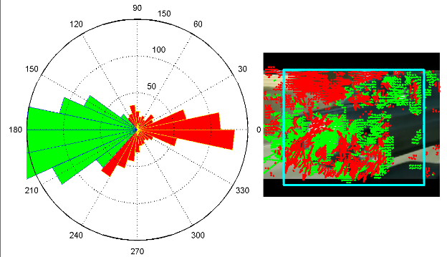
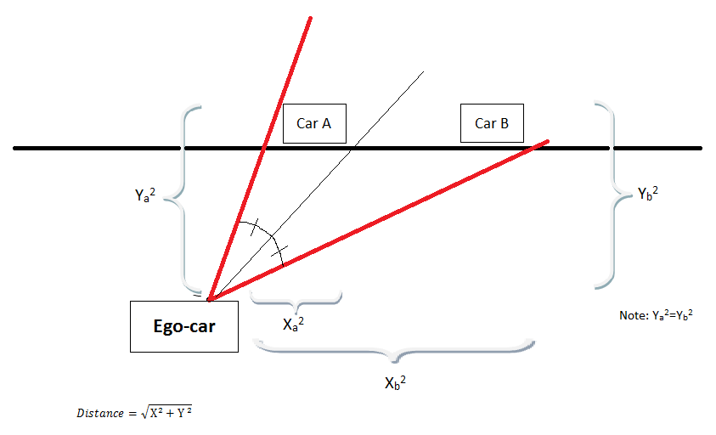
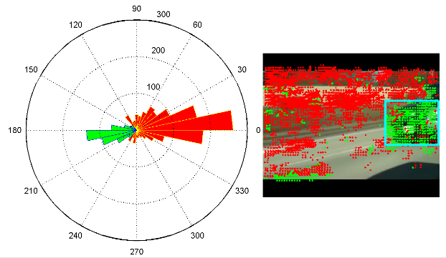
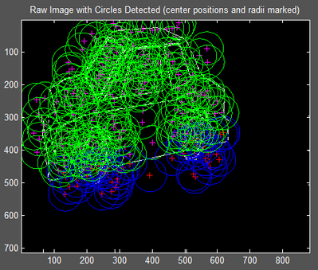
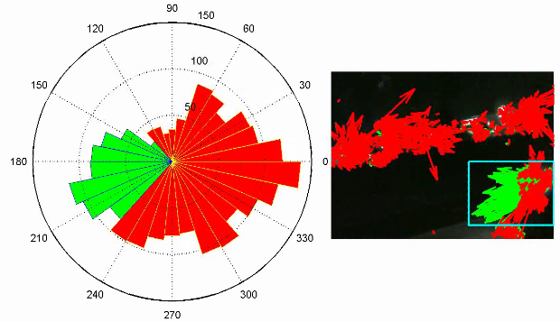
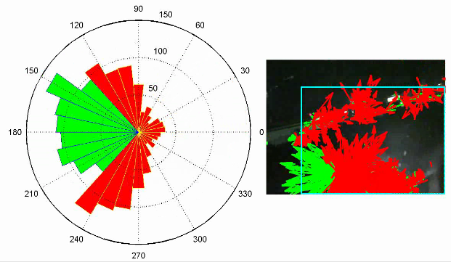
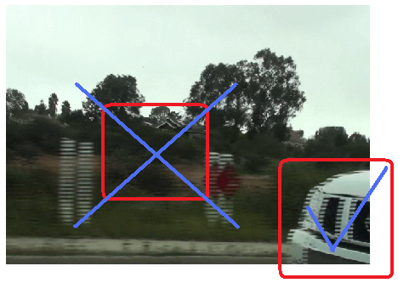
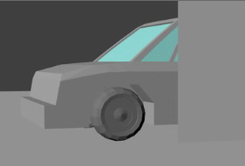
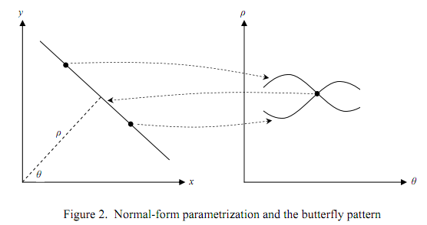
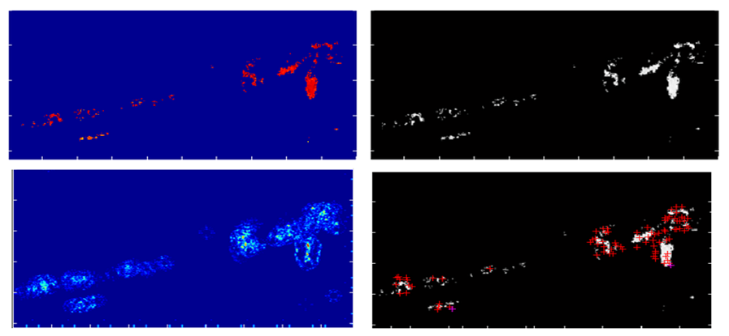
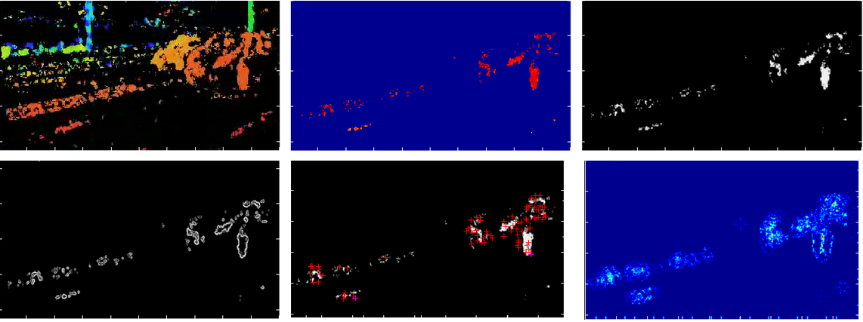
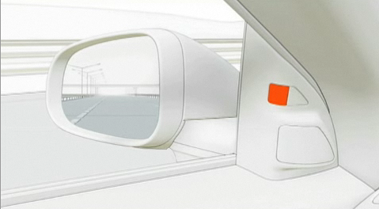
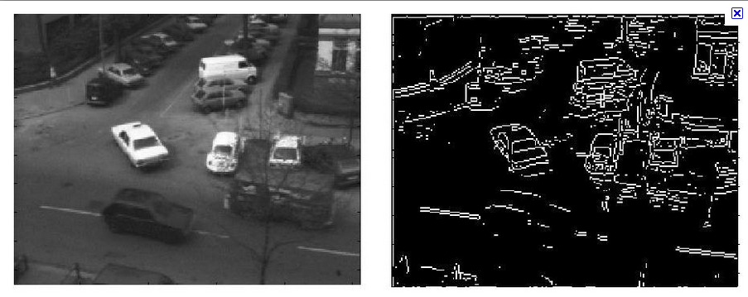
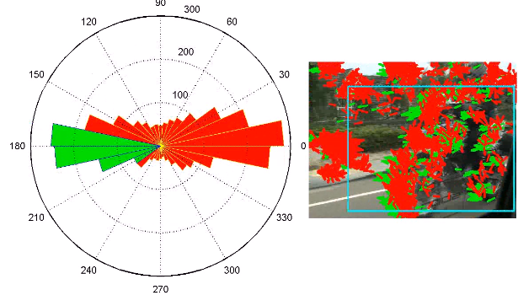
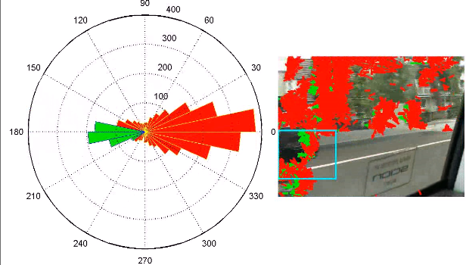
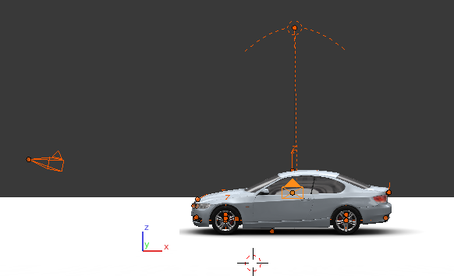
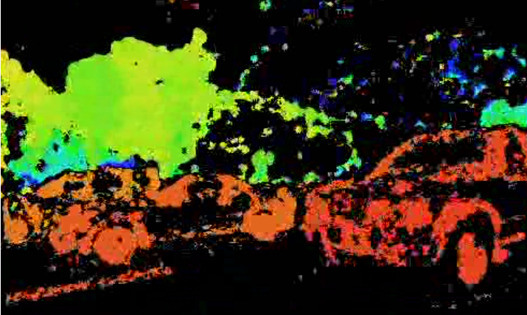
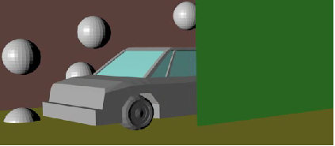
Ix, Iy, and It → derivatives of the image intensity level based on x, y, and time
α → constant that controls the smoothness of the pixel movement
[u, v] → 2-D optical flow vectors that are used to calculate movement.
Normal Object Overtake:
Pythagorean Nullification:
As the car approaches, the box is able to get bigger
The distance between the object and ego-car decreases as the object moves closer to the ego-car
X = Horizontal distance;
Y = Vertical distance
The car is immediately captured by
the box
Another popular format of the HS Algorithm
Advanced Techniques for Dual
Confirmation & Implementation
Under normal circumstances of sunlight, the plots show the presence of a car as it enters the blind spot.
Notice the scattered array of vectors in the quiver plot (unique to presence of light)
Take note that the shadow of the ego-car(bottom right of figure) does not generate motion vectors because it is stationary.
Notice that the green vector ratio substantially increases as the car approaches as designated by the massive green bars in the right image
Since X_{a}² < X_{b}² , and Y_{a}² = Y_{b}², then distanceCarA
is less than distanceCar B, meaning that Car A will appear
bigger than Car B
Advantage: nullify any small boxes on the left side
of the frame
Vehicle Wheel Detection:
Goal: To locate circles in a frame to find a vehicle’s wheels with Hough Transform
In the figure, the blue circles designate the wheels
Light Deficient Object Overtake:
False Box Safety Nullification:
A box is formed from the left/right because
a car initially comes from the sides.
Nullify any random boxes that appear
in the middle.
The headlights can be used
for object vectors
Hough Transformation :
Shapes are detected by looking for grouped points. If a shape is present ,then we can predict the remaining coordinates based on knowledge of the shape
Curve Detection – based on equation:
The lampposts and headlights of the cars behind serve as background
With no sunlight, the light generated from opposing cars, headlights and street lights are sufficient for vector generation
Notice the grouped array of vectors in the quiver plot (unique to lack of light) .
Notice however, that without light, the car body itself generates zero green vectors and is completely dependent on the headlights.
Make the box appear in the middle only if there is a lot of green object
vectors present
Triple Layered Blinking :
Objects with motion close enough for collision will create a red light
Objects with motion that could potentially cause danger will create a yellow light
The coding input is a line from two points; the points are then mapped on the parameter space (ρ,θ)
Multiple Object Overtake – Stereo Implementation:
Color filtering is done on Figure 2 to only show objects within a certain distance.
The image is then gray scaled, then edge detection is run through the image, and then the Hough transformation is run through the code, finally with Figure 6 as the output displaying the circle centers.
A blinker placed on the wing mirror = optimal for blind spot coverage
Edge Detection:
Increases productivity of Hough Transform
Frees the image from bad detail to focus on edges
Calculations are done in gray scale
The stereo output is isolated to only include the vectors close by. From there, the image is put through a Gaussian gradient and thresholded to produce a nimage of the blind spot vehicle. Edge detectors are used to nullify any insignificant points such that Hough Transform only has to make computations based on the car’s outline
Blender 3D: Python-Based Simulation
To test hard-to-mimic situations like static overtake, the data is simulated
Blender allows control over environment = less computational errors
The driving car was simulated by a Blender camera and travels at a set speed with the blind spot car
Tracking (Memory Incorporation) :
We set a threshold on how far the initial circles can move.
In a frame with more circles detected than wanted, choose the ones that fit the “position path “ of the circle in the previous frame
Variable Sized Object Overtake:
Notice that the code is able to track the motorcycle even as it leaves the screen
The wheels of the motorcycle are compatible with Hough Transform
Blind-Spot Camera
Light
Source
Inverse Object Overtake:
Uses Hough Transformation with Wheel Detection.
Since the car is moving in the same direction as the background, no green vectors will be generated , meaning that optical flow doesn’t work.
Backup Camera
Car Rig
Car
backbone
Stereo Depth Filtering :
Two cameras angled at a converging point can provide depth sight
The brightness of the pixel is directly proportional to the distance
Allows for differentiation of the background and the object
The coding is not restricted to detecting cars. It should work for objects of any size or shape (motorcycle) as long as motion is present. The idea can be extended to bicyclists, pedestrians, and skateboarders.
With the incorporation of wheel detection, it will be able to neglect the presence of birds or animals because few circles will be detected.
The bones of the vehicle allow the structure to move
Both the car and the camera have velocity to simulate background and object motion
Static Object Overtake:
A car moving at exactly the same velocity as the ego car will produce no object vectors
The program will shift to wheel detection when it thinks that static overtake is occurring – ie) when all the car vectors suddenly disappear
Greater distance = bluer pixel
Red pixel = closer objects
For blind spot, we can eliminate cars with light pixels
V( blind spot car) = V(driving car)
Conclusion
All of the trials ran supported that the code can accurately detect the blind spot object’s position and give a fair estimation of its velocity in various situations and circumstances
Implementation of the system would give drivers a visual stimulus to help prevent blind spot accidents.
The camera is positioned to move with the car at the same speed so that the balls and the colored walls appear to be moving backwards

